Slide 1


HR Analysis
Group 1

Slide 2



Group Members
Aakesh Dhanawade
Anjana
Nagesh Sonkamble
Jayanth
Shreyas
mansi

Slide 3
Understanding and Mitigating Employee Attrition in HR Departments
Employee attrition, particularly in the Human Resources (HR) department, can significantly impact an organization's operational efficiency and culture. High attrition rates can lead to increased recruitment costs, loss of institutional knowledge, and decreased employee morale. Understanding the factors contributing to HR attrition is crucial for developing strategies to retain valuable employees and maintain a stable workforce.
Introduction

Slide 4
Data Collection
Process
1
Data Understanding
2
Data cleaning + Modelling
3
4
Data Analysis

Slide 5

Data Overview
We are working with two datasets, HR1 and HR2, containing data for 50,000 employees.
The datasets encompass 18 columns.
Key columns in HR1 include Attrition, Department, Daily Rate, Employee Count, Gender, and Job Role.
HR2 focuses on Monthly Income, Monthly Rate, Total Working Years, and Years Since Last Promotion.

Slide 6
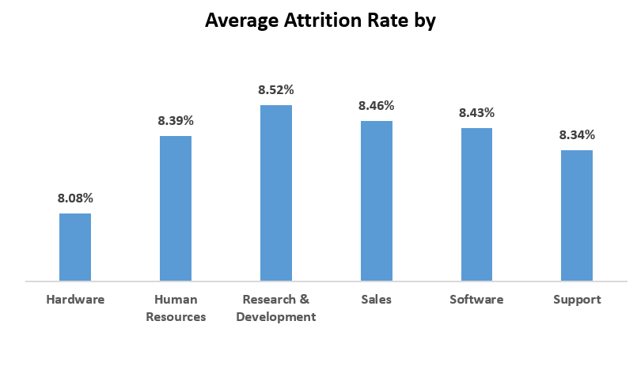
KPI 1
Highest Attrition: R&D department has the highest attrition rate at 8.52%, indicating a need for retention strategies in this area.
Low Attrition: Hardware department has the lowest attrition rate at 8.08%, suggesting effective retention strategies that could be modeled in other departments.
Consistent Attrition: HR, Sales, Software, and Support departments have similar attrition rates around 8.34% to 8.46%, indicating moderate retention challenges.

Slide 7
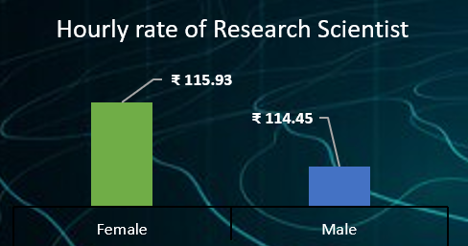
KPI 2
Gender Pay Gap: Female Research Scientists have a slightly higher average hourly rate (₹115.93) compared to their male counterparts (₹114.45).

Slide 8
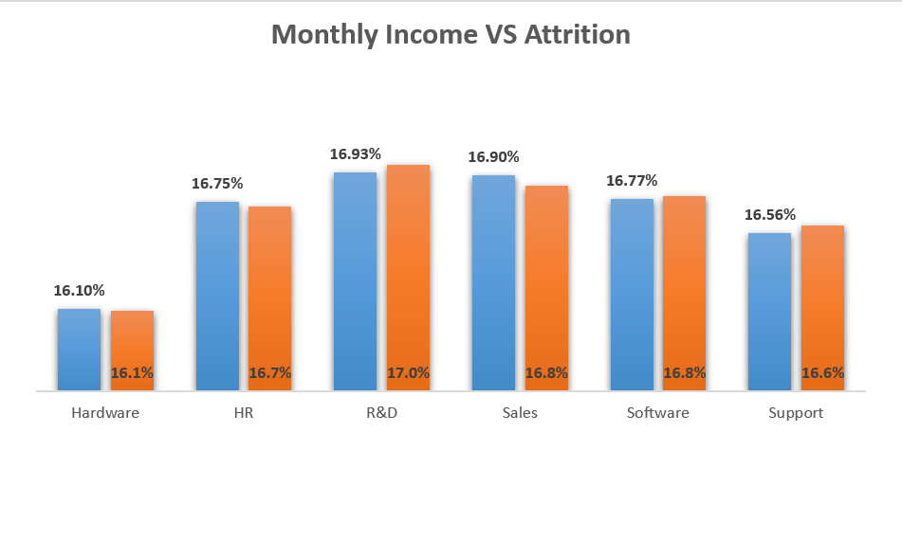
KPI 3
Income Correlation: Departments with higher average incomes do not necessarily have lower attrition rates, for ex. R&D has both high average income and high attrition rate indicating other factors are at play and suggesting that salary alone does not ensure retention.
Balanced Income: Departments like HR and Software have balanced monthly incomes and moderate attrition rates.

Slide 9
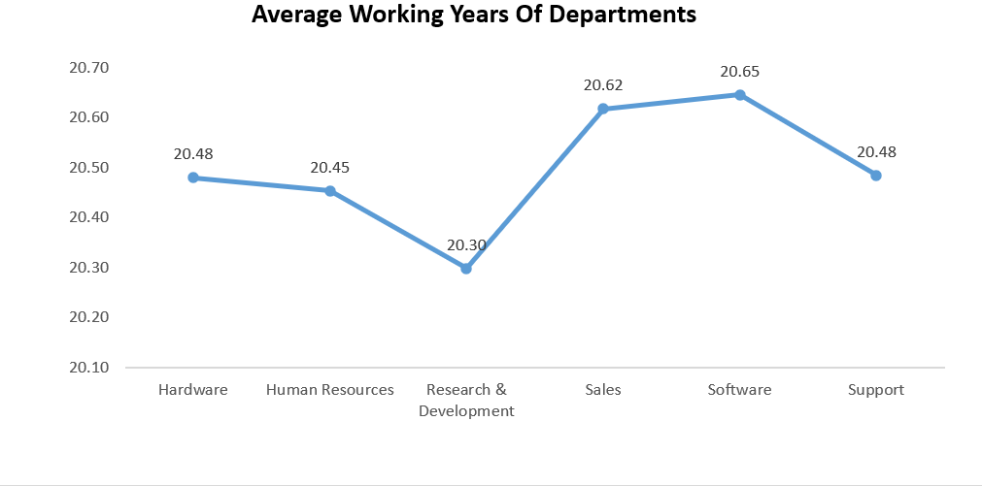
KPI 4
Retention Insight: Departments with higher average working years (e.g., Software and Sales) have lower attrition rates.
Longevity: Research & Development and Human Resources have the shortest average working years, correlating with higher attrition.
Employee Development: Investing in employee development and career growth could increase average working years in high attrition departments.

Slide 10
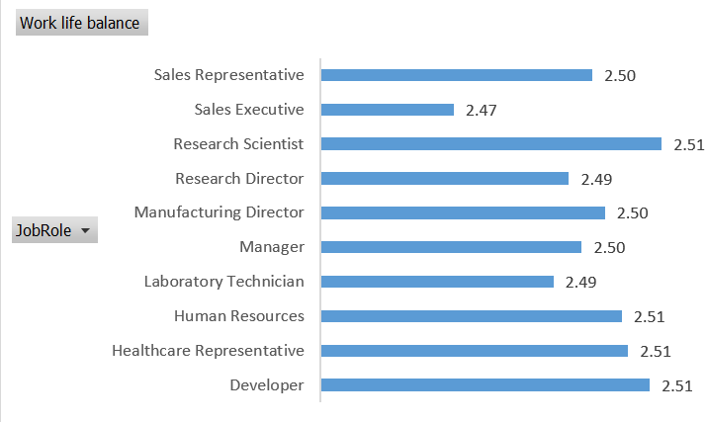
KPI 5
Consistent Ratings: Most job roles have similar work-life balance ratings, hovering around 2.50, indicating a general perception of work-life balance across roles.
Low Scores: Sales Executives and Laboratory Technicians have slightly lower ratings (2.47 and 2.49 respectively), suggesting targeted improvements could be made in these roles.
High Scores: Healthcare Representatives, Research Scientists, and Developers have a slightly higher rating (2.51), indicating better perceived work-life balance in these roles.

Slide 11
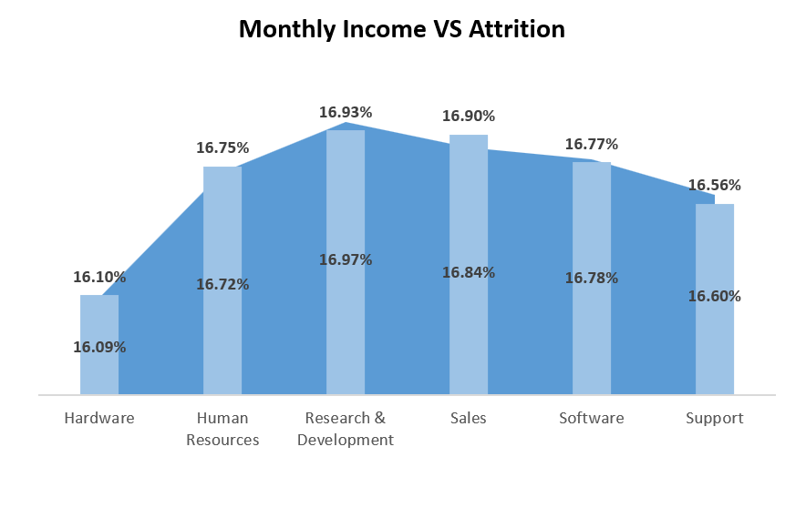
KPI 6
Promotion Impact: Higher attrition rates are associated with fewer promotions, indicating that career progression is crucial for employee retention.
Peak Attrition: The highest attrition rate is in R&D (17%), which aligns with fewer recent promotions.
Stable Rates: Hardware and Support departments show stable attrition rates with relatively consistent promotions.

Slide 12
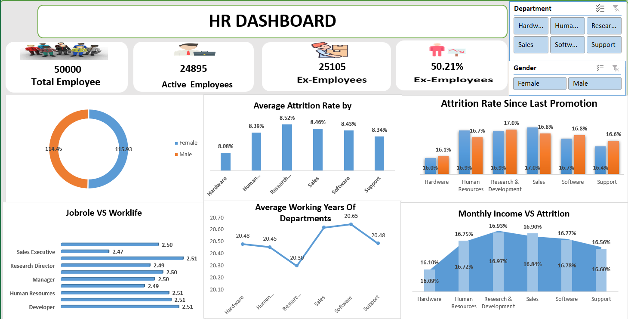
Dashboard

Slide 13
Analysis
High Overall Attrition Rate: The overall attrition rate is 50.21%, indicating that half of the employees have left the company.
Departmental Differences:
The R&D department has the highest attrition rate while the Hardware department has the lowest .This disparity indicates that some departments face more significant retention challenges than others, necessitating targeted interventions.
Promotion and Attrition Correlation:
There is a clear link between the time since the last promotion and attrition rates. Departments with fewer recent promotions, such as R&D, show higher attrition rates, indicating the importance of career progression in retaining employees.
Income and Attrition Insights:
High average income does not correlate with lower attrition rates. For example, the R&D department, with a high average income, also has a high attrition rate. This suggests that while competitive salaries are important, they are not sufficient alone to retain employees.
Gender Pay Equity:
The analysis of Research Scientists shows that female employees have a slightly higher average hourly rate than males. This points to positive steps toward gender pay equity.

Slide 14
Recommendations & Insights
Enhance Career Development Opportunities:Establish structured promotion pathways and invest in continuous learning programs to facilitate career advancement.
Address Department-Specific Issues:Conduct targeted surveys in high-attrition departments and apply successful retention strategies from low-attrition departments.
Improve Work-Life Balance:Introduce flexible working hours and wellness programs to help employees manage their work-life balance.
Competitive and Fair Compensation:Ensure salaries are competitive and address any pay disparities across all job roles and genders.
Strengthen Employee Engagement:Implement regular engagement surveys and recognition programs to understand employee concerns and celebrate achievements.
Monitor and Adapt Strategies:Continuously analyze HR metrics to evaluate and adjust policies, and encourage cross-departmental collaboration for best practices.

Slide 15


The dashboard reveals a high attrition rate of 50.21%, emphasizing the need for retention strategies.
A strong link between promotion frequency and attrition suggests career progression is vital.
Conclusion
While work-life balance is similar across job roles, notable differences in attrition rates and incomes between departments indicate a need for customized strategies.

Slide 16
Thank you!

